Slide 1
Types of Business Intelligence Tools and Applications
Ad hoc analysis
Online Analytical processing
Mobile BI
Real time BI
Operation Intelligence
Open-Source BI
Embedded BI
Collaborative BI
Location Intelligence
Business intelligence vendors and market
Sehrish Aqeel
www.aisciences.io

Slide 2

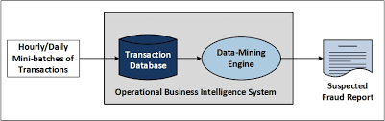
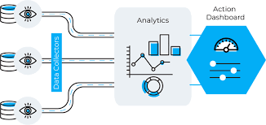
Operation Business Intelligence
Operational business intelligence (OBI or operational BI) is the process of reviewing and evaluating operational business processes, activities and data for the purpose of making tactical, strategic business decisions.
OBI allows businesses to quickly react to dynamic and continuously changing business and customer requirements.

Slide 3
